Slide 1

BRAIN TUMOR CLASSIFICATION, SEGMENTATION AND SURVIVAL PREDICTION
Under the Guidance of - Dr. Mohammad Al-Antary
Presented by- Anushka Pradeep Kadam

Slide 2
INTRODUCTION
Brain tumors, a highly complex and fatal type of cancer.
Early detection and accurate classification are crucial for optimizing treatment plans.
Traditional diagnostic methods, such as MRI and CT scans, while effective, have limitations, including invasiveness and variability in manual interpretation.
Recent advancements in medical imaging and machine learning have led to more sophisticated automated brain tumor detection and segmentation techniques, such as convolutional neural networks (CNNs), which excel in learning complex image features.

Slide 3
OBJECTIVE
Evaluate and compare the performance of transfer learning models (InceptionV3, MobileNetV2, ResNet152V2, VGG19) for brain tumor classification.
Develop and optimize 3D U-Net and 3D Attention U-Net for accurate tumor segmentation.
Predict patient survival using machine learning models like Random Forest, Gradient Boosting, SVM, and Voting Classifier ensemble.

Slide 4
LITERATURE REVIEW
Research Focus | Methodology/Model | Key Findings
CNN-based classification of brain tumors | Simple CNN, GoogleNet, Transfer Learning, CapsNet | Achieved accuracies from 84.19% to 99.04%. Highlights the effectiveness of CNN and transfer learning in classifying brain tumors.
Minimalist CNN for Glioma, Meningioma, Pituitary | Simple CNN (Abiwinanda et al.) | Training Accuracy: 98.51%, Validation Accuracy: 84.19%.
Feature extraction and classification using GoogleNet | GoogleNet with 5-fold cross-validation (Sajjad et al.) | Achieved model accuracy of 98%.
Ensemble of CNNs for high/low-grade glioma classification | CNN Ensemble (Ertosun et al.) | Accuracies: 96% (HGG vs LGG), 71% (LGG Grades I vs II).
CapsNet for spatial relationship-based classification | Capsule Network (CapsNet) (Afshar et al.) | Achieved 86.56% (segmented tumors), 72.13% (unprocessed images).

Slide 5
Biomedical image segmentation with DRINet | Dense-Res-Inception Net (DRINet) (Liang et al.) | DSCs: 83.47% (whole tumor), 73.41% (tumor core),64.98%(enhancing tumor).
Glioma segmentation and OS prediction | Fully Convolutional Neural Network (FCNN) - Varghese et al. (2017) | sed a 23-layer deep FCNN trained on 2D slices from MRI data of 130 patients, validated on 50 patients.Achieved Dice Scores: Whole Tumor: 0.83, Tumor Core: 0.69, Active Tumor: 0.69. OS prediction accuracy: 60%.
Tumor segmentation and OS prediction | Ensemble Model of DeepMedic and 3D U-Net Variations | Combined 19 variations of DeepMedic and 7 variations of 3D U-Net models, using features such as age, spatial, volumetric, and morphological characteristics. Achieved 70% accuracy with ground truth features and 63% with network segmentation features on a dataset of 59 patients.
Hybrid models for better segmentation and prediction | Dense CNN + MLP Regressor (Kori et al.) | OS Prediction Accuracy: 50%.
PixelNet for tumor segmentation and survival prediction | PixelNet + ANN (Islam et al.) | DSC: 88%, OS Prediction Accuracy: 54.5%.

Slide 6
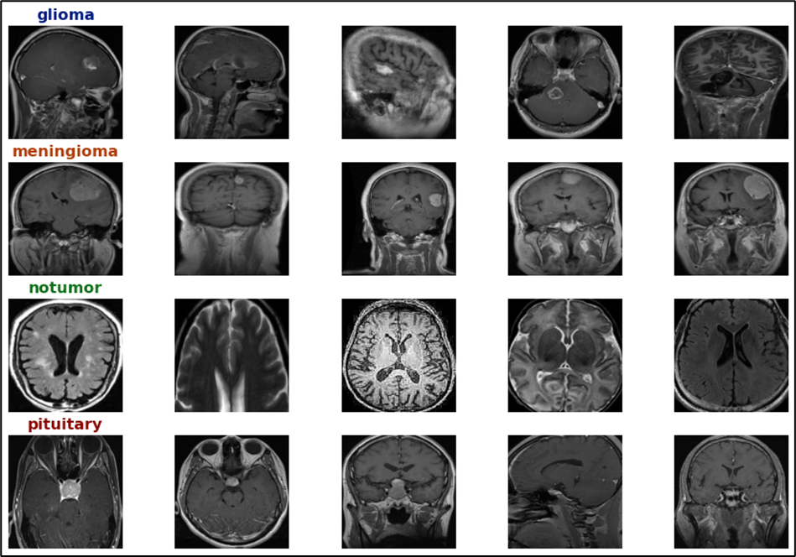
DATASETS
The dataset comprised 5734 images in training and 1311 images in testing folder, categorized into four distinct classes: glioma, meningioma, pituitary, and no tumor.
Distribution of training/testing:
o Glioma: 1321/300 images
o Meningioma: 1339/306 images
o Pituitary: 1457/300 images
o No Tumor: 1595/405 images

Slide 7
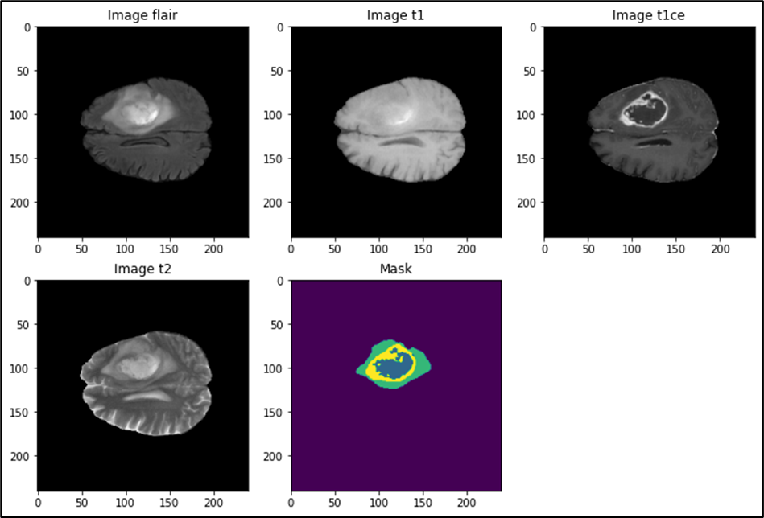
DATASETS
Manual segmentation by 1-4 raters following a standardized protocol.
Annotations include:
GD-enhancing tumor (ET - label 4)
Peritumoral edema (ED - label 2)
Necrotic and non-enhancing tumor core (NCR/NET - label 1)

Slide 8
CLASSIFICATION MODELS
Model | Key Components | Unique Features
InceptionV3 | - Multi-size convolutions (1x1, 3x3, 5x5). - Auxiliary classifiers. | - Multi-scale feature extraction with Inception Modules. - Factorized Convolutions to reduce computation. - Reduction Layers for dimension control.
MobileNetV2 | - Depthwise separable convolutions. - Inverted residual blocks with linear bottlenecks. | - Depthwise Separable Convolutions to reduce computations. - Inverted Residuals for efficient gradient flow and expressiveness.
ResNet152V2 | - Residual blocks with identity mappings. - Batch normalization and ReLU after additions. | - Skip Connections to combat vanishing gradients. - Bottleneck layers optimize depth with lower computation costs.
VGG19 | - Sequential 3x3 convolutions. - Max pooling layers. - Fully connected layers at the end. | - Uniform, Simple Design with only 3x3 convolutions and 2x2 max pooling. - Deep Network without drastic increase in parameters.

Slide 9
CLASSIFICATION
KEYS STEPS:
Exploring and preprocessing data. Crop and Clean Images Process Images and Save Cleaned Versions
Data Augmentation Using ImageDataGenerator
Building Transfer Learning Models Loaded the pre-trained Models Freeze the top Layers Added custom Layers Compiled the models
Baseline Model: Dummy Classifier
Ensemble Methods for Enhanced Performance
Compute Inference Time and Trade-Off Analysis

Slide 10
SEGMENTATION MODELS
Feature | 3D U-Net | 3D Attention U-Net
Architecture | Encoder-decoder structure with skip connections for precise localization. | Extends 3D U-Net with Attention Gates to focus on relevant features.
3D Adaptation | Processes volumetric data (3D MRI scans) to capture spatial context for better segmentation. | Refines feature maps using attention mechanisms to enhance focus on critical areas (e.g., tumors).
Key Components | - Encoder: Convolution + max pooling for feature abstraction. - Decoder: Upsampling to reconstruct segmentation. | - Attention Gates: Improve feature selection in skip connections to filter out irrelevant features.
Main Advantage | Simple, effective for general segmentation tasks. | Better segmentation by focusing on tumor regions, reducing false positives and improving boundaries.

Slide 11
SEGMENTATION
Preprocessing data Augmentation for Attention 3D UNET
Attention blocks
Model Building
Evaluation IoU Score
Predicting the segmented regions
Calculated Per Class Accuracy

Slide 12
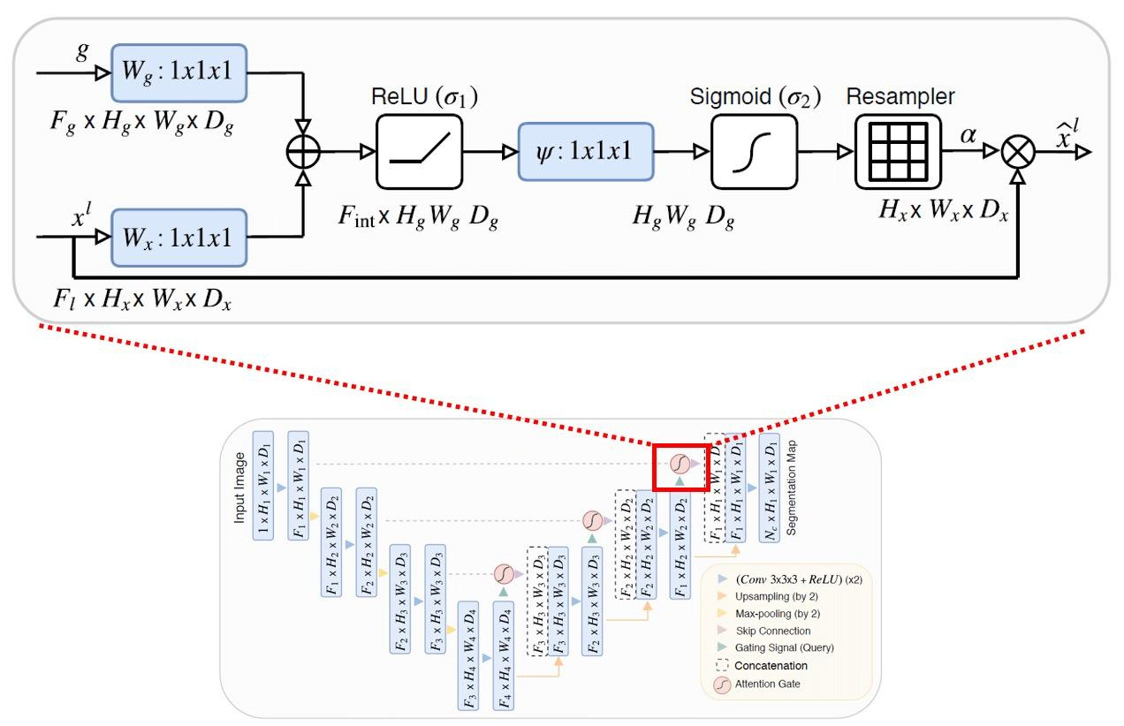
Attention 3D UNET

Slide 13
SURVIVAL PREDICTION
Extracted Features:
Image-Based: Tumor volumes (necrotic core, edema, enhancing tumor).
Clinical Data: Age, extent of resection (encoded).
Data Processing:
Imbalance Handling: Used SMOTE to balance survival categories.
Feature Scaling: Standardized using StandardScaler.
Machine Learning Models Used
Random Forest (RF):
An ensemble-based method using multiple decision trees to improve prediction accuracy and reduce overfitting.
Gradient Boosting (GB):
A sequential boosting technique that builds an additive model by optimizing weak learners.
Support Vector Machine (SVM):
Effective for high-dimensional data; finds the hyperplane that best separates different classes.
Voting Classifier (Ensemble Model):
Combines predictions from RF, GB, and SVM using a soft voting strategy for enhanced performance.

Slide 14
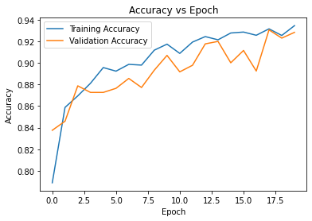
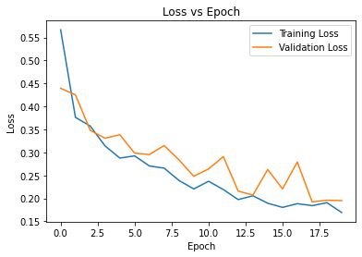
RESULTS - CLASSIFICATION
Inception V3

Slide 15
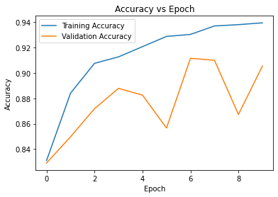
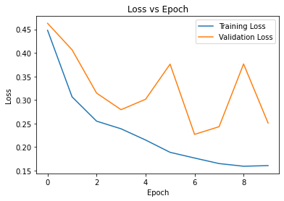
RESULTS - CLASSIFICATION
MobilenetV2

Slide 16
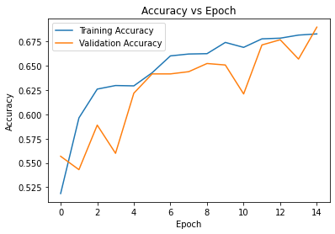
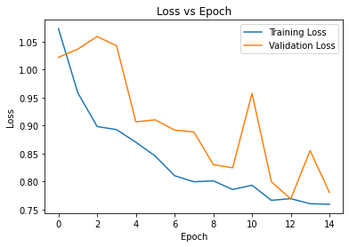
RESULTS - CLASSIFICATION
Resnet152v2

Slide 17
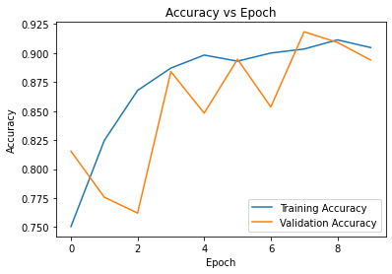
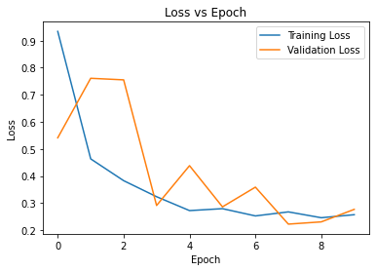
RESULTS - CLASSIFICATION
VGG19

Slide 18
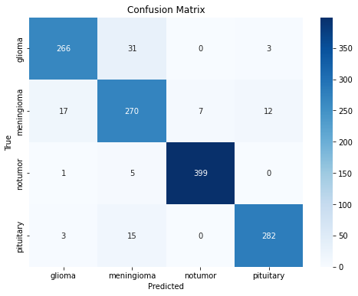
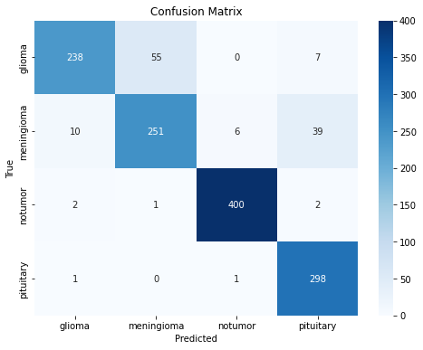
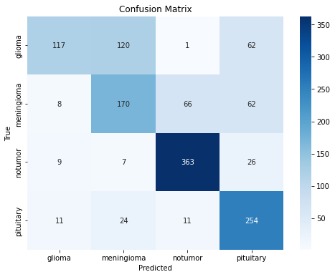

Inception V3
MobilenetV2
Resnet152v2
VGG19

Slide 19
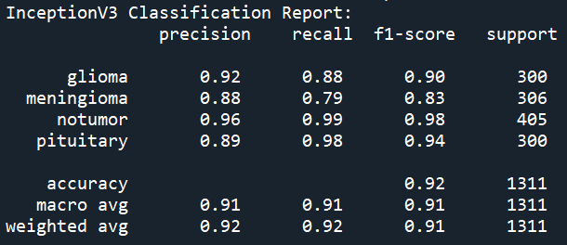
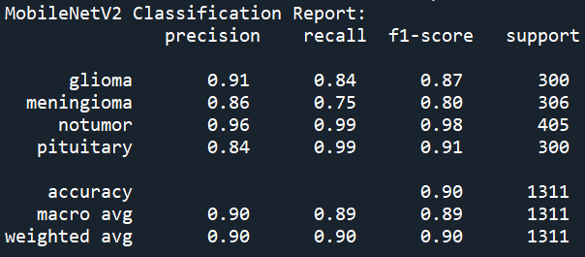
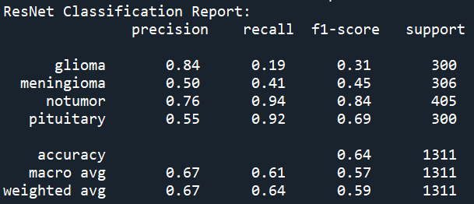
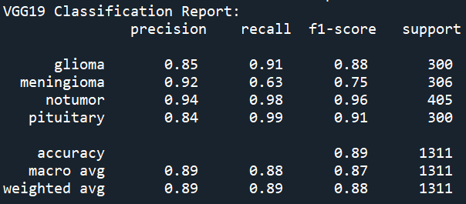
Classification Report

Slide 20
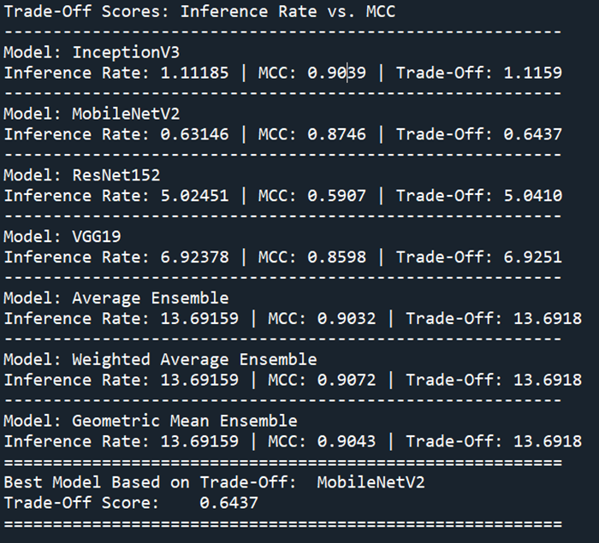
Trade off

Slide 21
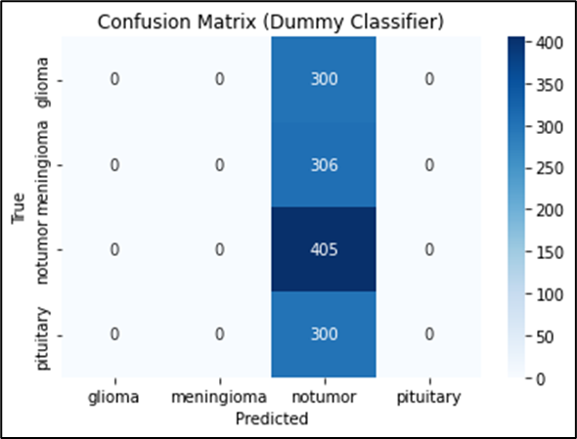
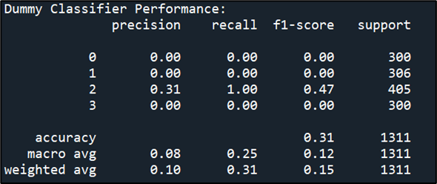
COMPARING TO BASELINE MODEL

Slide 22
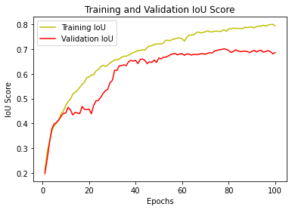
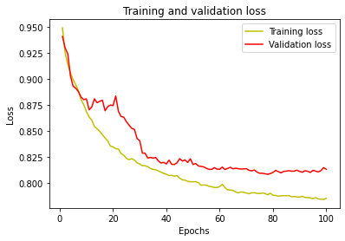
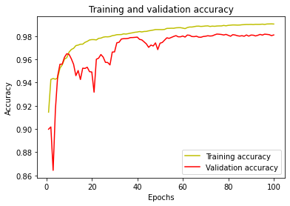
RESULTS - SEGMENTATION
3D UNET

Slide 23
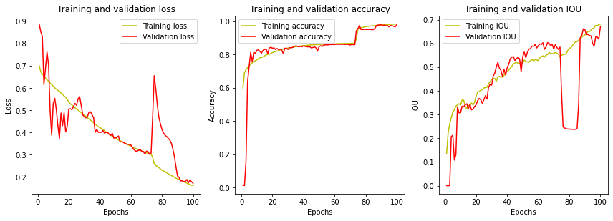
RESULTS - SEGMENTATION
Attention 3D UNET

Slide 24
RESULTS - SEGMENTATION
 | 3D U-Net Model | 3D Attention U-Net Model
Mean IoU (validation) | 0.7454 | 0.6919
Accuracy Class-Wise | 3D U-Net Model | 3D Attention U-Net Model
Class 0 (Background) | 99.66% | 98.82%
Class 1 (Core) | 64.04% | 62.30%
Class 2 (Edema) | 84.55% | 92.95%
Class 3 (Enhancing Tumor) | 80.67% | 83.64%

Slide 25
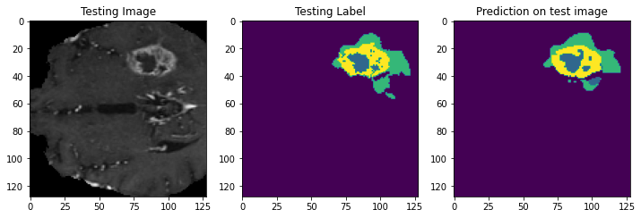
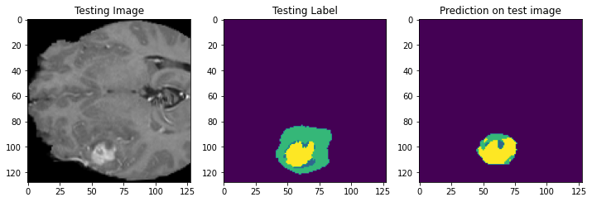
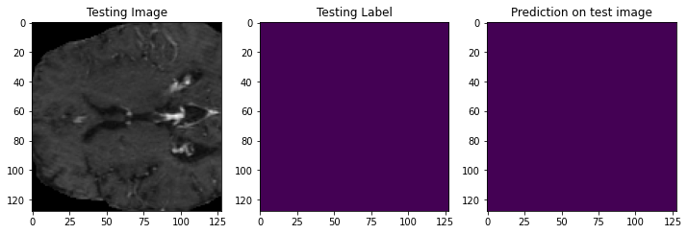
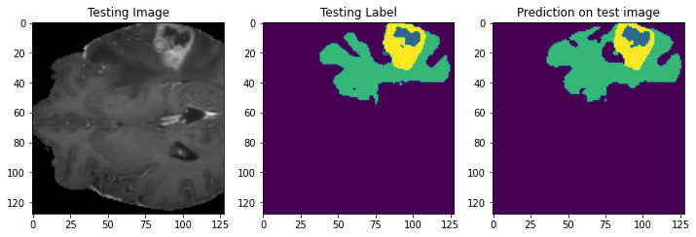
The colors represent specific regions –
▪ green for edema,
▪ yellow for the core,
▪ blue for the enhancing tumor.
3D UNET PREDICTED IMAGES

Slide 26
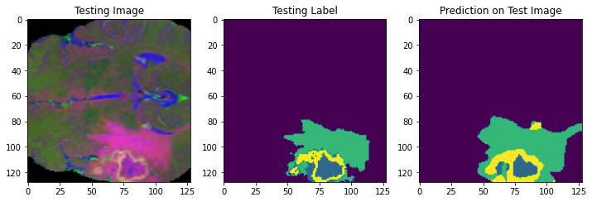
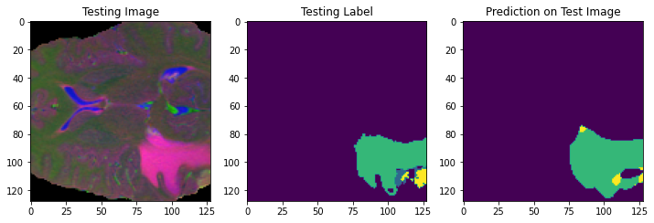
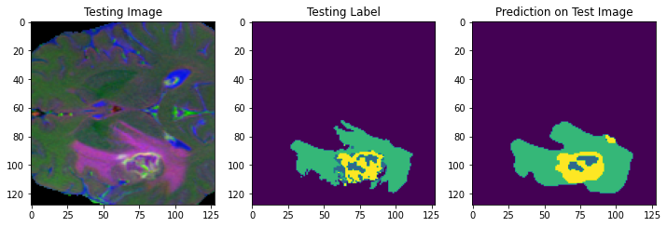
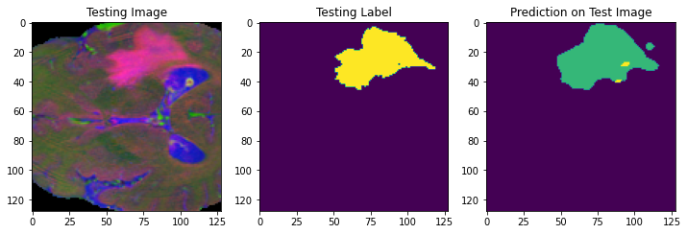
The colors represent specific regions –
▪ green for edema,
▪ yellow for the core,
▪ blue for the enhancing tumor.
ATTENTION 3D UNET PREDICTED IMAGES

Slide 27
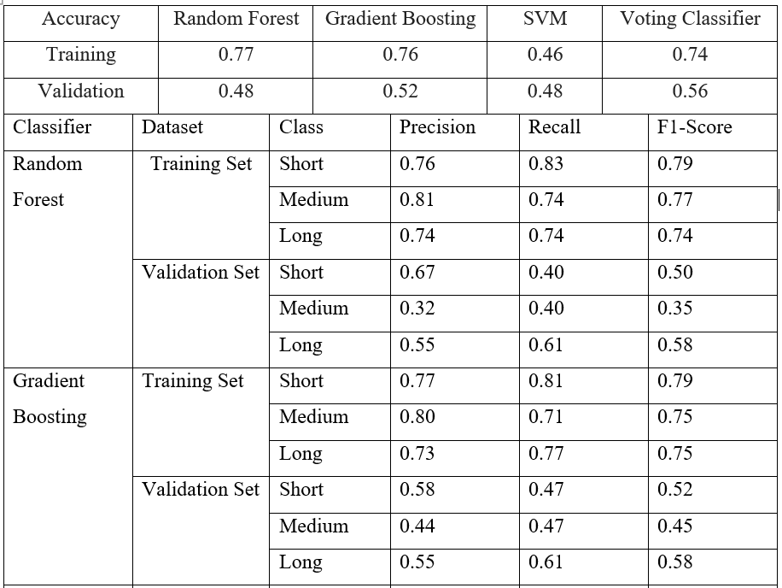
RESULTS - SURVIVAL PREDICTIONS

Slide 28
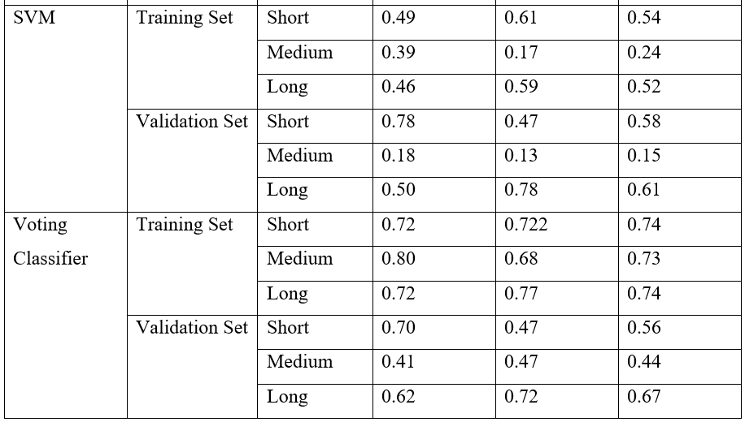

Slide 29
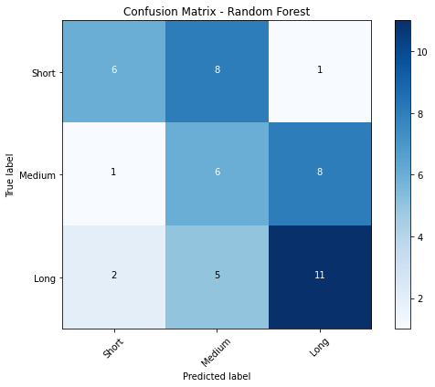
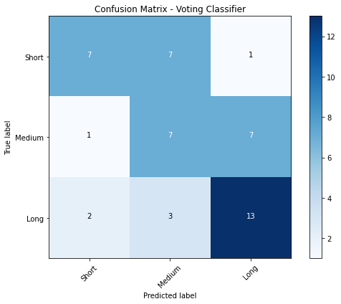
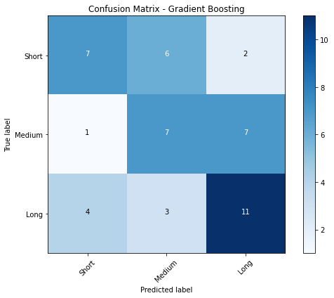
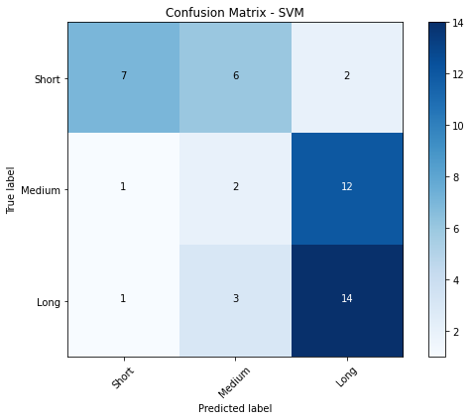

Slide 30
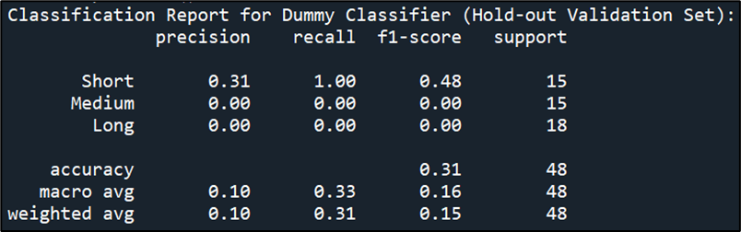
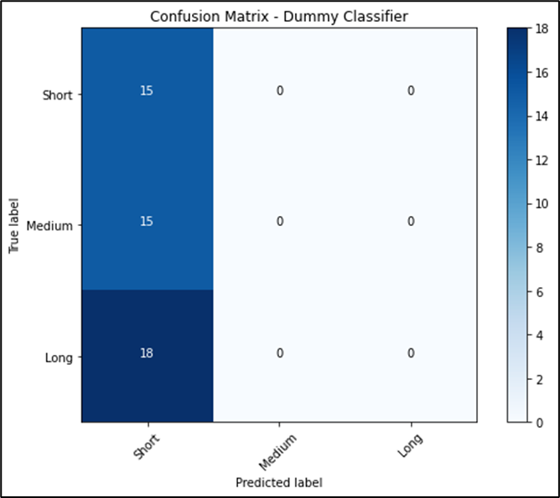
COMPARISON TO BASELINE MODEL

